Slide 1
Stress Management
The greatest weapon against stress is our ability to choose one thought over another

Slide 2
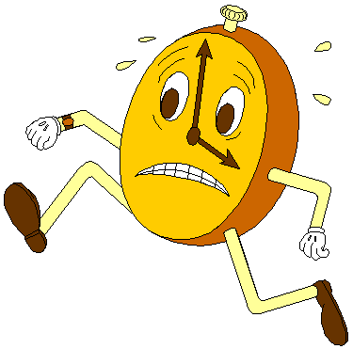
Guidelines

Slide 3
Company Profile

Slide 4
Trainer Profile
Notes:
Introduction:
My Self
(Name, Age, Academic background)
Career experience
First job as a call center agent
Going through stress
Goal from this course
Everyone Introduce Himself
Name
Experience
Goal from this course

Slide 5
What is Stress?
“Stress is a state of worry or mental tension caused by a difficult situation” – WHO Definition
“Stress is a state of mental or emotional strain or tension resulting from adverse or demanding circumstances” – Dictionary Definition
“pattern of negative physiological responses occurring in situations where people perceive threats to their well being which they may be unable to meet” – Psychologists Definition
Notes:
Who among us has stress?

Slide 6
What is Stress?
“
Stress is the psychological, physiological and behavioral response by an individual when they perceive a lack of equilibrium between the demands placed upon them and their ability to meet those demands, which, over a period of time, leads to ill-health
“
S. Palmer (1989). Occupational stress. The Health and Safety Practitioner

Slide 7
Stress Impact on Us
Health decay
(High blood pressure, Heart diseases, Diabetes, Hearing and sight decay)
Psychological diseases
(Anxiety, Depression, Insomnia)
Negative impact on social relationships
Negative impact on career
Making wrong decisions
Main reason for failure

Slide 8
Stress Symptoms
Rapid anger
Hand sweat
Muscles tension
Anxiety
Lack of focus
Sleeping disorder
Frequent irritation
Crying without a reason
Feeling lonely
Emotional disorder
Social isolation
Increased average of heart beat
Mood swing

Slide 9
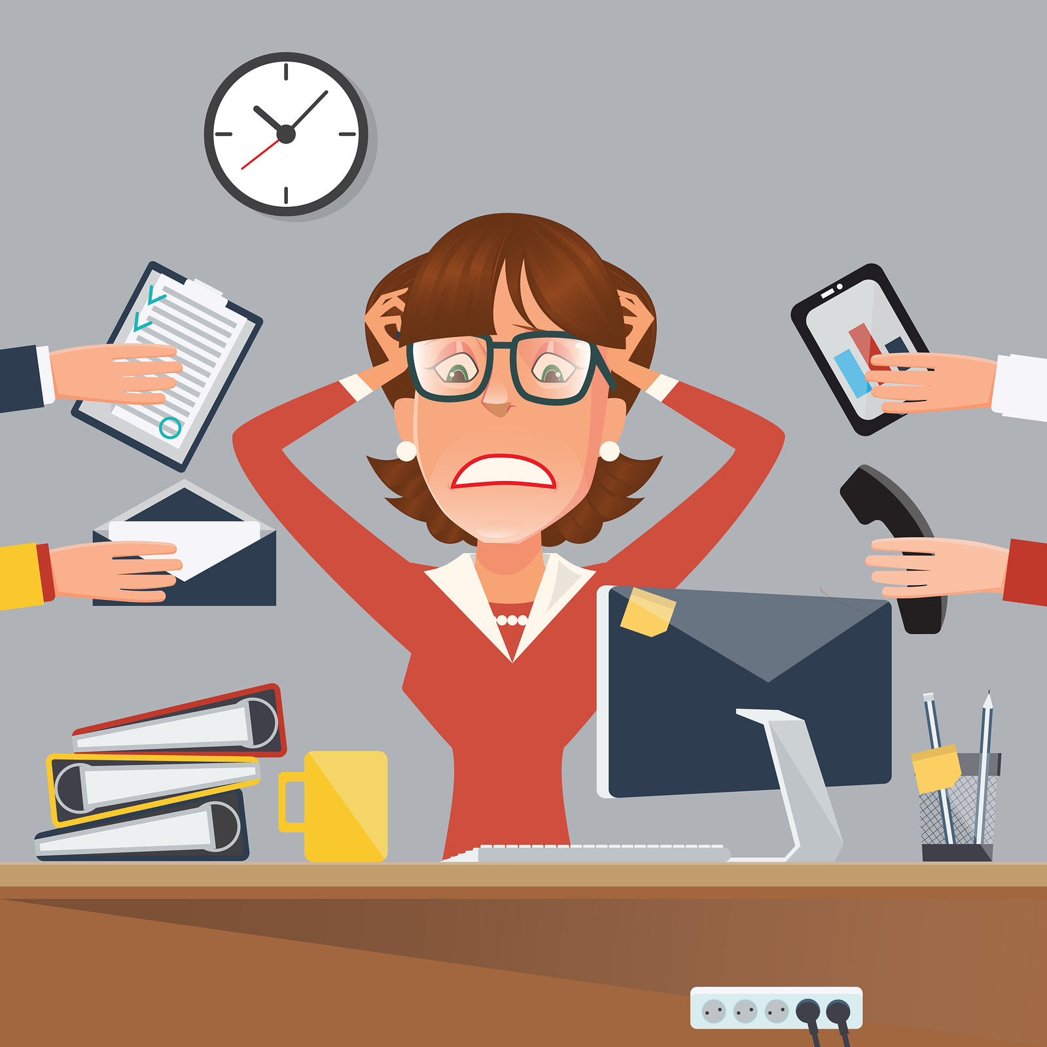
Exercise 1
List 10 things or behaviors that cause you to be stressed
Notes:
Goal: is to identify your stressors
List the things that stress you out
It is very important to identify your stressors

Slide 10
Stressors
Income
Time
Responsibilities
Family
Superiors
Pessimism
Friends
Notes:
Stressors:
Lack of Financial Income
Lack of Time
Responsibilities (At Work, At Home)
Family (Spouse, Parent, Children)
Superiors (Achieve Target, Not Cooperative, Meticulous)
Friends (Negative, Unfaithful, Competitive)
Pessimism (Half of the glass is empty)
“I just have a million things going on right now”
“Things are always crazy around here”

Slide 11
Equilibrium
Physical Balance
Balance Nutrition
Psychological Balance
Social Balance
Avoid Solitude
Socialize
Deeds
Positivity
Self Appreciation
Personal Goals
Balanced Sleep
Regular Exercise
Everyone is susceptible to stress, the safest way is to prevent yourself from falling into it.
Notes:
The balanced lifestyle reduce the chances of having a stressful life
Physical Balance
Balance Nutrition (Good, Variety, Clean, Cover all nutrients – emphasize on vitamins)
Balanced Sleep (Early, Same time, Same amount, Use “Power Naps”)
Regular Exercise (Play football, Gym, Walk, Dance, ect.)
Psychological Balance
Positivity (Find positive sides everywhere, It comes by practice)
Personal Goals (Set some, year resolution, Evaluate your progress)
Self Appreciation (Celebrate your achievements, You deserve better)
Social Balance
Avoid Solitude (Different personalities, but at least one buddy!, Solitude is a punishment, Training on building a network)
Stay in-touch (Family, Distant Family, Dear Friends)
Good Deeds (Make you feel good about your self, volunteering)

Slide 12
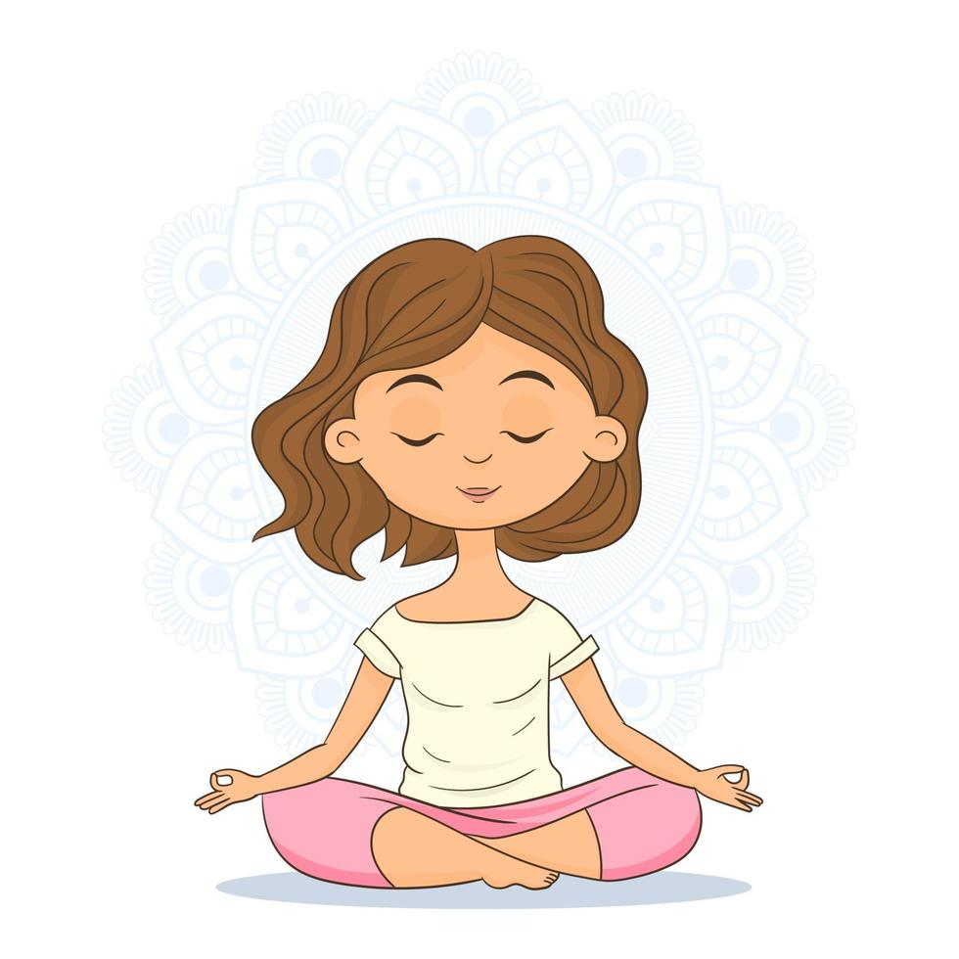
Exercise 2
List 10 things or behaviors that help you to relieve your stress
Notes:
Goal: is to identify your stress relieves
List the things that relieve your stress

Slide 13
Common Healthy Stress Relieves
Having Fun | Fun activities help the blood circulation, body muscles and produce joy.
Listening to Jokes | Comedy helps reducing stress and distracts from undesirable thoughts.
Walking / Exercising | Exercising helps focusing and reduces tension.
Drinking Water | Water helps the body to waste toxics and improves blood circulation.
Little Nap | Naps can renew your energy and help exiting from tension.
Hot / Cold Drink | Healthy drinks help on relaxation.
Watching Movies / Shows | Watching helps on exiting tension and encourages imagination.
Practicing Hobby | Hobbies can help you energize and reduce tension.
Talking to a Friend | Talking help to reduce tension and gain emotional support.
Reading a Book | Reading helps in reducing tension and imagination.

Slide 14
Stress Log
Date | Stressor | Physical Symptoms | Psychological Symptoms | Reaction | Stress Relief | Improvement
What is a “Stress Log”?
Why do we need a stress log?
How can we benefit from recording the stress moments?
Notes:
It is a registry for stress incidents
We use it to track our stress moments, stressors, our reactions, and improve our reactions
We should study it regularly and come up with ways to improve our reactions

Slide 15
Exercise 3
Every 3 to 4 people together
Write an imaginary stress log
Notes:
Goal: learn and practice writing a stress log

Slide 16
Types of Stressors
Examples of Internal Stressors:
Inability to accept uncertainty
Pessimism
Negative self-talk
Unrealistic expectations
Rigid thinking, lack of flexibility
All-or-nothing attitude
Need to always be perfect
Internal Stressors
External Stressors
Notes:
Small Quick Exercise
Make some one stand in a circle within a circle
Put labels on the floor within these circle
Show that we see external reasons more than internal reasons
Differentiate Between
Fear or Careful
Pessimism or Criticism
Greed or Competitiveness
Worry or Planning

Slide 17
Strategies to Manage Stress
Stress Managing Strategies
Change The Situation
Change Your Behavior
Change The Stressor
Avoid The Stressor
Accept The stressor
Adapt to The Stressor

Slide 18
Short Story
“
I’m Not A Dumpster
“
Notes:
Tell the story about a complainer friend who drove his friend life to the negative side every time they met, until one day, his friend told him: “I’m not your dumpster”

Slide 19
Strategies to Manage Stress: Change The Stressor
Express your feelings instead of bottling them up.
Be willing to compromise.
Be more assertive.
Manage your time better.
Notes:
Express your feelings instead of bottling them up. If something or someone is bothering you, communicate your concerns in an open and respectful way. If you don’t voice your feelings, resentment will build and the situation will likely remain the same.
Be willing to compromise. When you ask someone to change their behaviour, be willing to do the same. If you both are willing to bend at least a little, you’ll have a good chance of finding a happy middle ground.
Be more assertive. Don’t take a backseat in your own life. Deal with problems head on, doing your best to anticipate and prevent them. If you’ve got an exam to study for and your chatty roommate just got home, say up front that you only have five minutes to talk.
Manage your time better. Poor time management can cause a lot of stress. When you’re stretched too thin and running behind, it’s hard to stay calm and focused. But if you plan ahead and make sure you don’t overextend yourself, you can alter the amount of stress you’re under.

Slide 20
Exercise 4: Role Play
Every 2 people together
Take one of the listed roles while the other try to avoid this person.
Roles:
Loud Co-worker (Makes humming and other noises)
Annoying Co-worker (Takes your belongings without permission)
Bossy Manager (Takes your parking spot that you have paid for)
Notes:
Goal: Practice Changing the stressor

Slide 21
Strategies to Manage Stress: Avoid The Stressor
Learn to say “NO”.
Avoid people causing you to stress out.
Be in control; Take control of your environment.
Avoid stressing topics conversations.
Pare down your to-do list.
Notes:
Learn how to say “no” – Know your limits and stick to them. Whether in your personal or professional life, taking on more than you can handle is a surefire recipe for stress.
Avoid people who stress you out – If someone consistently causes stress in your life and you can’t turn the relationship around, limit the amount of time you spend with that person or end the relationship entirely.
Take control of your environment – If the evening news makes you anxious, turn the TV off. If traffic’s got you tense, take a longer but less-traveled route. If going to the market is an unpleasant chore, do your grocery shopping online.
Avoid hot-button topics – If you get upset over religion or politics, cross them off your conversation list. If you repeatedly argue about the same subject with the same people, stop bringing it up or excuse yourself when it’s the topic of discussion.
Pare down your to-do list – Analyze your schedule, responsibilities, and daily tasks. If you’ve got too much on your plate, distinguish between the “shoulds” and the “musts.” Drop tasks that aren’t truly necessary to the bottom of the list or eliminate them entirely.

Slide 22
Exercise 5: Role Play
Every 2 people together
Take one of the listed roles while the other try to avoid this person.
Roles:
Grumpy Person
Controlling Person
Person likes to discuss stressful topics
Notes:
Goal: Practice avoiding the stressor

Slide 23
Strategies to Manage Stress: Accept The Stressor
Don’t try to control the uncontrollable.
Look for the upside.
Share your feelings.
Learn to forgive.
Notes:
Some sources of stress are unavoidable. You can’t prevent or change stressors such as the death of a loved one, a serious illness, or a national recession. In such cases, the best way to cope with stress is to accept things as they are. Acceptance may be difficult, but in the long run, it’s easier than railing against a situation you can’t change.
Don’t try to control the uncontrollable. Many things in life are beyond our control— particularly the behavior of other people. Rather than stressing out over them, focus on the things you can control such as the way you choose to react to problems.
Look for the upside. As the saying goes, “What doesn’t kill us makes us stronger.” When facing major challenges, try to look at them as opportunities for personal growth. If your own poor choices contributed to a stressful situation, reflect on them and learn from your mistakes.
Share your feelings. Talk to a trusted friend face to face or make an appointment with a therapist. The simple act of expressing what you’re going through can be very cathartic, even if there’s nothing you can do to alter the stressful situation. Opening up is not a sign of weakness and it won’t make you a burden to others. In fact, most friends will be flattered that you trust them enough to confide in them, and it will only strengthen your bond.
Learn to forgive. Accept the fact that we live in an imperfect world and that people make mistakes. Let go of anger and resentments. Free yourself from negative energy by forgiving and moving on.

Slide 24
Short Story
“
Steaming Off Prevents Explosion
“

Slide 25
Strategies to Manage Stress: Adapt to The Stressor
Reframe problems
Look at the big picture.
Adjust your standards.
Focus on the positives.
Notes:
Reframe problems. Try to view stressful situations from a more positive perspective. Rather than fuming about a traffic jam, look at it as an opportunity to pause and regroup, listen to your favourite radio station, or enjoy some alone time.
Look at the big picture. Take perspective of the stressful situation. Ask yourself how important it will be in the long run. Will it matter in a month? A year? Is it really worth getting upset over? If the answer is no, focus your time and energy elsewhere.
Adjust your standards. Perfectionism is a major source of avoidable stress. Stop setting yourself up for failure by demanding perfection. Set reasonable standards for yourself and others, and learn to be okay with “good enough.”
Focus on the positive. When stress is getting you down, take a moment to reflect on all the things you appreciate in your life, including your own positive qualities and gifts. This simple strategy can help you keep things in perspective.

Slide 26
Exercise 6:
Everyone by his own, in a piece of paper, try to connect all the nine dots with 4 straight lines only without taking the pen off the paper.
Notes:
Goal: Reset boundaries and encourage creativity.
If every one knows it, then give them the exercise of cutting a circle to 8 pieces with 3 lines

Slide 27
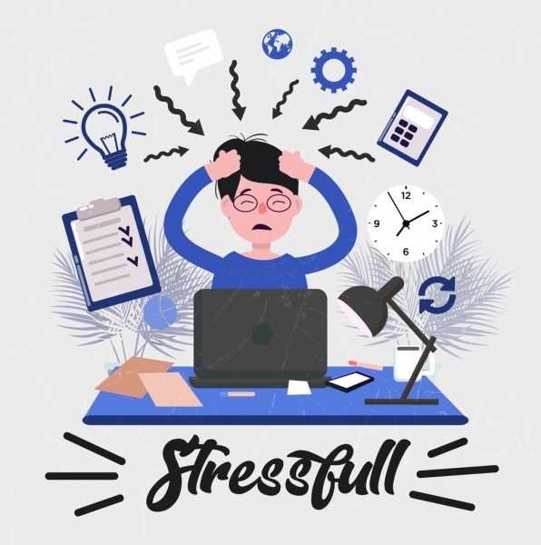
Exercise 7:
Everyone by his own, in a piece of paper, list 4 of your own stressors (one from each category) and how are you going to deal with it in the future.
Notes:
Goal: Projecting the theory on to real life scenarios

Slide 28
Tasks Prioritizing
Important & Urgent tasks are the top of your list
Unimportant & Not Urgent task are at bottom of your list
What about what is important but not urgent? Is it always being taken over by urgent but not important?
High Importance
Low Urgency
High Importance
High Urgency
2
1
Importance
4
3
Low Importance
Low Urgency
Low Importance
High Urgency
Urgency
Notes:
Prioritize your tasks
Important & Urgent tasks are the top of your list
Unimportant & Not Urgent task are at bottom of your list
What about what is important but not urgent?
Is it always being taken over by urgent but not important?
If there is time make exercise
Write number of life task, then give the training to put them on the board of priority.

Slide 29
Exercise 7:
Every in his seat or around it.
Follow the instructor with some lite morning exercise and stretching.
Background sound: Forest, Nature, Ocean, Rain or any relaxing sound.
Notes:
Goal: To discover the impact of morning exercises and routines.

Slide 30
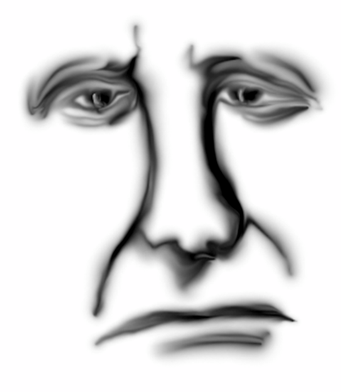
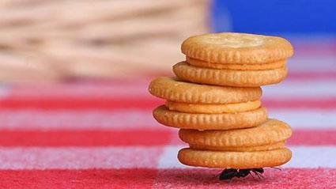
Energy Givers & Takers

Slide 31
Energy Givers & Takers
Energy Givers or Energizers are the activities and the people that radiate positive energy and leave you feeling recharged and inspired.
They uplift your spirits and make you feel good about yourself and the world around you.
Energy Takers or Drainers are the activities and people that drain your energy and leave you feeling depleted and exhausted.
After interacting with such people, or doing those activities, you are left feeling emotionally and physically drained.
A refreshing glass of water
A warm cup of coffee or tea
Movement
Stretching
Exercise
Fresh air
Supportive friends and family
People you can be yourself with
People that make you feel happy
Boundary setting
Reading
Self-care
A warm hug
Journaling
Working on your hobbies
Dancing
Massages
Volunteering
Deep breathing
Nutritious, wholesome food
Power naps
Good sleep habits
Music
Trying and learning new things
Traveling
Dreams and goals that you are working towards
Practicing gratitude
Growth mindset
Spending time with pets
Spiritual Practice
Family members with persistent negative vibes or toxic behaviors
Social media accounts that trigger comparatives or make you feel envious
People that make you feel inadequate
People who are always creating drama or chaos
People who violate your boundaries
Not being clear about your boundaries
Psychoanalyzing every person, every conversation, every action
Constantly complaining
Repressing your emotions
Junk food
Binge-eating
Overthinking
Over-exercising
Poor sleep hygiene
Excessive screen time
Excessive stress
Excessive alcohol
Foregoing rest for productivity
Not taking a break
Perfectionism
Being passive aggressive
Resentment / anger / envy
Victim mindset

Slide 32
Energy Givers & Takers
Energizing
Reduce Drainers
Convert Drainers to Energizers
Increase Energizers

Slide 33
You deserve to be loved so you must start by loving yourself.

